Slide 1
Services
Session 8
Course : Mobile Community Solution
Effective Period : September 2019

Slide 2
Learning Objectives
At the end of this meeting is expected that students will be able to:
  Describe the main features of Android Programming and Android Software Development
  Produce simple Mobile Application using the main features of Android
  Construct Mobile Application based on Android Platform

Slide 3
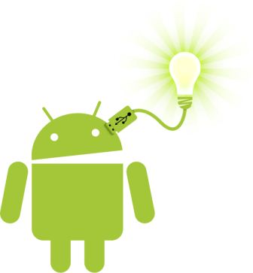
Contents
Creating Services
Communication between Services and Activity
Log
Notification
Binding Activities to Services
Threading

Slide 4

What is a Service?
A Service is an application component that can perform long-running operations in the background and does not provide a user interface.
Android Built-in services include the notification service, location service, alarm service, and download service
Service good for:
  Network Transactions
  Play music
  Perform file I/O
  Interact with a database
Characteristics of services:
  Started with an Intent
  Can stay running when user switches applications
  Lifecycle-must manage
  Other apps can use the service-manage permissions

Slide 5
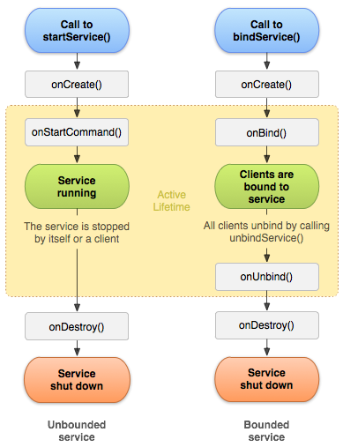
Forms of Services: started
Started with startService()
Runs indefinitely until it stops itself
Usually does not update the UI
Use started services for tasks that run in the background to perform long-running operations. Also use started services for tasks that perform work for remote processes.

Slide 6
Forms of Services: bound
Offers a client-server interface that allows components to interact with the service
Clients send request and get results
Started with bindService()
Ends when all clients unbind
Use bound services for tasks that another app component interacts with to perform interprocess communication (IPC).
For example, a bound service might handle network transactions, perform file I/O, play music, or interact with a database.

Slide 7
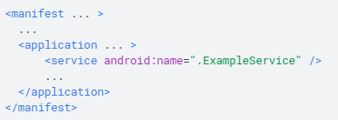
Declaring a service in the manifest
You must declare all the services in your application’s manifest file
The <service> element contains two attributes: name and exported.
The name attribute tells Android what the name of the service is- ExampleService
The exported attribute tells Android whether the service can be used by other apps. False means that the service will only be used within the current app.

Slide 8
Started service
How a service Start
An app component such as an activity calls startService() and passes in an Intent. The Intent specifies the service and includes any data for the service to use.
The system calls the service onCreate() method and any other appropriate callbacks on the main thread. It’s up to the service to implement these callbacks with the appropriate behavior, such as creating a secondary thread in which to work.
The system calls the service’s onStartCommand() method, passing the intent supplied by the client.
When the operation is done, the service should stop itself by calling stopSelf(), or another component can stop it by calling stopService()

Slide 9
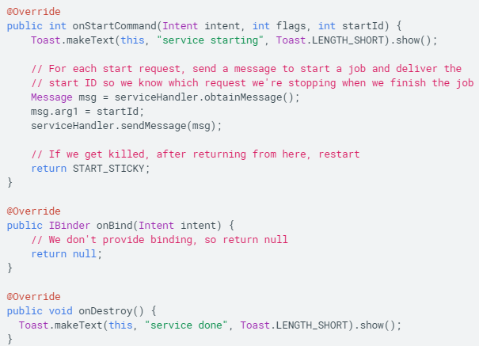
Started Service
onStartCommand()

Slide 10
Started Service
onStartCommand() Cont.
The return value of onStartCommand() must be one of the following:
  START_NOT_STICKY
    Do not recreate the service unless there are pending intents to deliver.
  START_STICKY
    Recreate the service and call onStartCommand() but do not redeliver the last intent. The system calls onStartCommand() with a null intent unless there are pending intents to start the service.
  START_REDELIVER_INTENT
    Recreate the service and call onStartCommand() with the last intent that was delivered to the service. Any pending intents are delivered in turn.

Slide 11
Intent Service
IntentService automatically provides a worker thread to handle your intent
IntentService handles some of the boilerplate code that regular services need (such as starting and stopping the service)
IntentService can create a work queue that passes one intent at a time to your onHandleIntent() implementation, so you don’t’ need to worry about multi-threading
IntentService limitations:
  Cannot interact with the UI
  Can only run one request at a time
  Cannot be interrupted

Slide 12
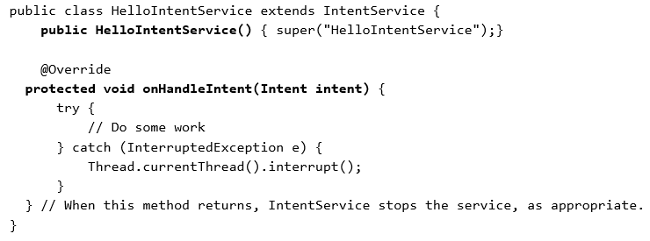
Intent Service
Implement IntentService
Provide a small constructor for the service
Create an implementation of onHandleIntent() to do the work that the client provides.

Slide 13
AsyncTask
Use AsynTask to implement basic background tasks
doInBackground() – runs on a background Thread
  All the work to happen in the background
onPostExecute() – runs on main thread when work done
  Process results
  Publish results to the UI
Main Thread (UI Thread)
onPostExecute()
Worker Thread
doInBackground()

Slide 14
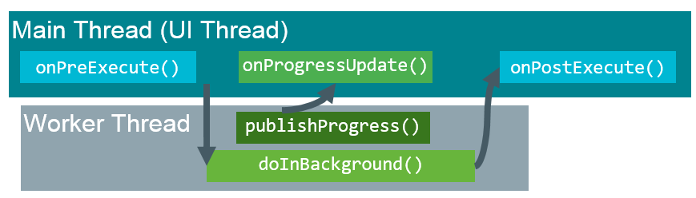
AsyncTask
AsynTask Helper methods
  onPreExecute()
    Runs on the main thread
    Sets up the task
  onProgressUpdate()
    Runs on the main thread
    Receives calls from publishProgress() from background thread

Slide 15
AsyncTask
Limitations of AsyncTask
  When device configuration changes, Activity is destroyed
  AsyncTask cannot connect to Activity anymore
  New AsyncTask created for every config change
  Old AsyncTask stay around
  App may run out of memory or crash
When to use AsyncTask
  Short or interruptible tasks
  Tasks that do not need to report back to the UI or user
  Lower priority tasks that can be left unfinished
  Use AsyncTaskLoader otherwise

Slide 16
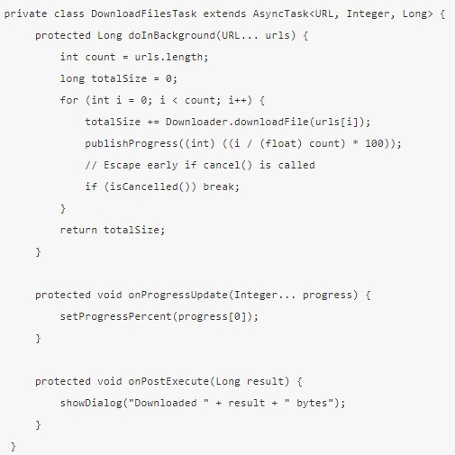
AsyncTask
Example Implementing AsyncTask

Slide 17
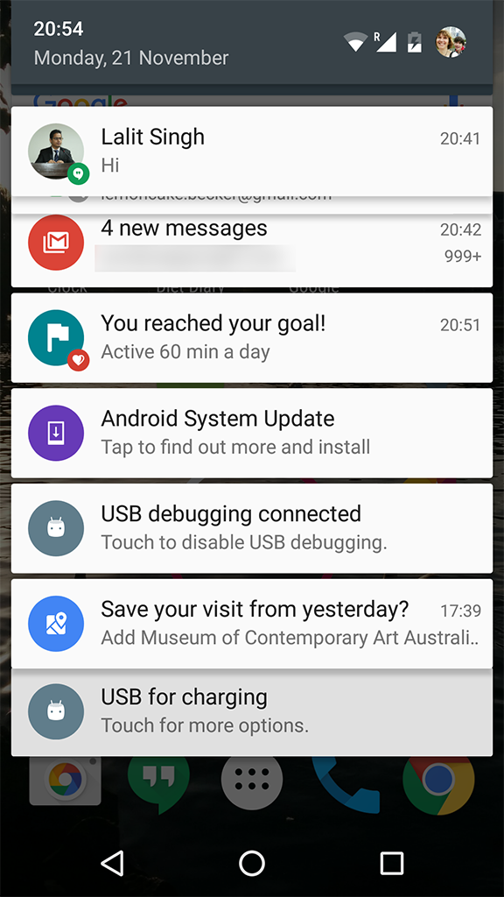
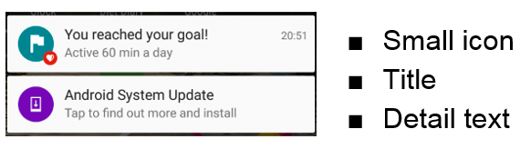
Notification Service
Notifications are messages that are displayed outside the app’s user interface.
Android issues a notification that appears as icon on the status bar.
To see details, user opens the notification drawer.
User can view notifications any time in the notification drawer.

Slide 18
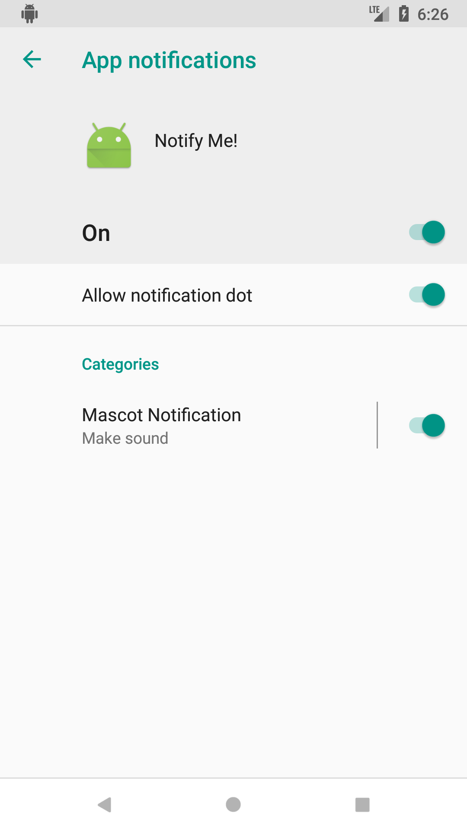
Notification Service
Notification Channels
Used to create a user-customizable channel for each type of notification to be displayed.
More than one notification can be grouped in to the channel.
Set notification behavior like sound, light, vibrate, and so on, applied to all the notifications in that channel.
Notification channels are introduced in Android 8.0 (API level 26) and all channel must be assigned to a channel, or else your notifications will not be displayed.
Notification channels appear as categories under App notifications in the device settings

Slide 19
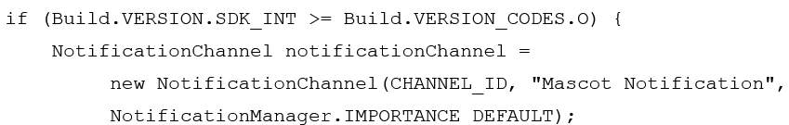
Notification
Implementing Notification channel
Notification channel instance is created using NotificationChannel constructor.
You must specify:
  An ID that’s unique within your package
  User visible name of the channel.
  The importance level for the channel.

Slide 20
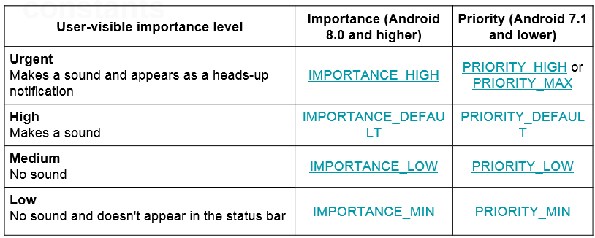
Notification
Importance and priority

Slide 21
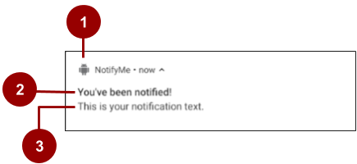
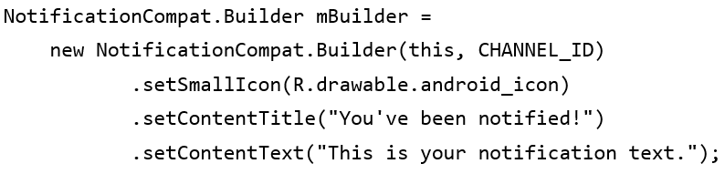
Notification
Creating Notification
A small icon, set by setSmallIcon(), this is the only content that’s required
A title, set by setContentTitle().
The body text, set by setContentText(). This is the notification message

Slide 22
References
Head First Android Development. A Brain friendy guide. Dawn Griffiths and David Griffiths.O’reilly. ISBN:978-1-449-36218-8. Chapter 18
https://google-developer-training.github.io/android-developer-fundamentals-course-concepts-v2/

